Slide 1

CHANGE OF COMPANY DIRECTORS AND
CC MEMBERS
Presented by Mashudu Thomas Lebete

Slide 2
Change of company directors
Customers may chose to transact either manually or through e-services
Step by step guide of electronic transactions available on website by clicking on Access/How to – step by step guides
Manual Transaction
Complete manual CoR39 application
Attach supporting documents
Scan the documents and e-mail them to manualcor39@cipc.co.za
Once the process has been completed, CIPC will send the certificate or query to the e-mail address linked to the customer code used for the application

Slide 3
Change of company directors
Transaction via E-Services
Visit the CIPC website, www.cipc.co.za, and click on “On-line transacting”
Click on company director changes (CoR39)
Click on customer login and insert login details
Select amend company director details

Slide 4
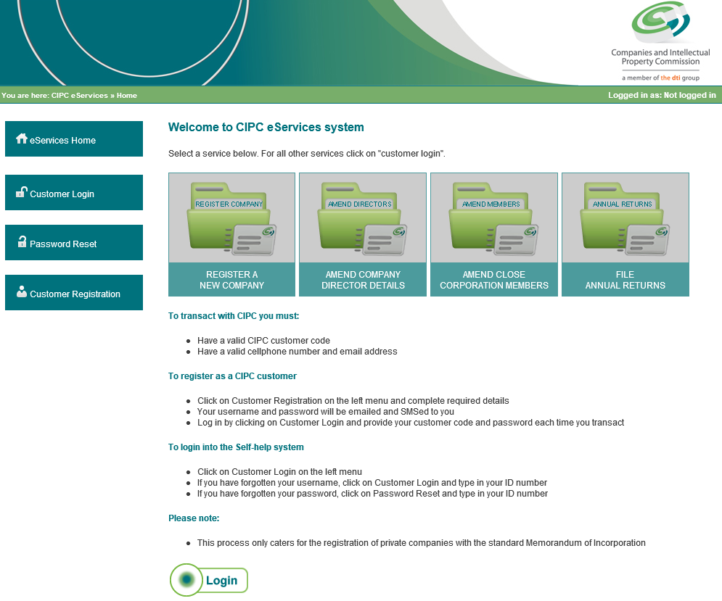

Change of company directors

Slide 5
Change of company directors
Complete the registration number of the company, and all the required fields and click on Submit.
CIPC will send an electronic CoR39 to your e-mail address (the e-mail address registered on the customer code). Print the document and at least one director must sign
The signed form and the supporting documents must be scanned and e-mailed to eservicescor39@cipc.co.za
Important: application must be in pdf or tiff format and only scanned as one attachment

Slide 6
Supporting documents required: Change of company directors
Required for both manual and e-services transactions
Notice of the meeting
Round robin resolution or minutes of the meeting
Certified ID copies (death certificate)
Once the process has been completed, CIPC will send the certificate or query document to the e-mail address linked to customer code used for that transaction

Slide 7
Removal of directors
There is a difference between resignation of a director and the removal of a director.
In terms of section 71 (1), a director may be removed by an ordinary resolution adopted at a shareholders meeting by persons entitled to vote in an election of directors
The director concerned must be given a notice of the meeting and the resolution
Affected director must be afforded a reasonable opportunity to make a presentation in person, or through representative, to the meeting, before the resolution is put to a vote

Slide 8
Removal of directors
CIPC required the following supporting documents
A proof that a notice was sent to the director concerned
Attendance register
Certified copy of the share register
4. When a director is removed by the board on the grounds of being eligible or disqualified, or due to incapacity or neglect, the company must have more than 2 directors

Slide 9
Removal of directors
5. Point 4 above is not applicable if the company has fewer than 3 directors, and sec 71(8) applies whereby any director or shareholder of the company may apply to the Companies Tribunal to make a determination
A court order is required for disqualification and rehabilitation of a director

Slide 10
Disqualification of a director
A court must make an order declaring a person to be a disqualified director
A person may be disqualified on the grounds of misconduct involving dishonesty, or has been convicted in any court of law for theft or fraud
A disqualified person must not be appointed or elected as a director of a company, or consent to be appointed or elected as a director

Slide 11
Disqualification of a director
4. The company must not knowingly permit ineligible or a disqualified person to serve or act as a director
5. Disqualification is valid for not less than 5 years after the date of removal from the office, and the court may lift that disqualification if the person is fully rehabilitated, or even extend disqualification by not more than 5 years, if the court is satisfied that an extension is necessary to protect the public

Slide 12
Change of CC members (CK2)
Customers may chose to transact either manually or through e-services
By manual transaction the customer must:
Complete a manual CK2 application (Form available on website)
Attach supporting documents
Scan the documents and e-mail them to manualck2@cipc.co.za
Once the process has been completed, CIPC will send the certificate or query to the e-mail address linked to the customer code used for the application

Slide 13
Change of CC members (CK2)
When transacting through e-services, the customer must
Visit CIPC website, www.cipc.co.za, and click on “On-line transacting”
Click on CC member changes (CK2)
Click on customer login and insert login details
If details are correct, select continue

Slide 14
Change of CC members (CK2)
Complete registration number of the CC, complete the required fields and click on Submit
CIPC will send an electronic CK2 to your e-mail address that must be printed and signed by all members
The signed form and the supporting documents must be scanned and e-mailed to eservicesck2@cipc.co.za
Application must be in pdf or tiff format and scanned as one attachment

Slide 15
Supporting documents for
Change of CC members (CK2)
Both manual and e-services transactions
Notice of the meeting
Round robin resolution or minutes of the meeting signed by all members
Certified ID copies
Once the process has been completed, CIPC will send the certificate or query document to the e-mail address linked to customer code used for that transaction

Slide 16
Change of deceased member
Customer must submit CK2 application
Executorship letter from the Master of the High Court
Certified ID copy of the executor
The Executor must sign on behalf of the deceased

Slide 17
Appointment of a Trust as a member of a CC
When a Trust is appointed as a member of the CC, the CK2 application has to be completed manually.
Supporting documents required:
Letter by a trustee stating the following:
The name, registration number and address of the trust
The names of all the trustees of the trust
The number of beneficiaries of the trust, and particulars of all the beneficiaries named in the trust deed

Slide 18
Appointment of a Trust as a member of a CC
A certified copy of the letter of authority issued to the trustee/s of the trust by the Master of the High Court
In case of multiple trustees, an originally signed power of attorney by each of the trustees appointing one of them as representative of the trustee
A certified copy of the section in the trust deed identifying the beneficiaries of the trust (beneficiaries may not exceed 10)

Slide 19
CoR39 & CK2 processing times
Manual applications
30 business days for both CoR39 and CK2
E-services applications – no urgent processing
5 business days for both CoR39 and CK2
Customers are encouraged to transact via e-services since this is a much quicker and convenient process that also eliminate spelling errors.

Slide 20
THANK YOU
QUESTIONS…?

