Slide 1
Co-operative Director changes
Date: 27 September 2022

Slide 2
Co-operative Directors
References during this presentation that refers to “the Act” means the Co-operatives Act 14 of 2005, as amended.
Section 32 – 39 of the Act refers to Governance of Co-operatives and bears reference to Directors and changes to Directors.

Slide 3
Record Keeping
A co-op must keep the following Records at its office:
Accounting Records, which must include all business transactions with Members and Non-members.
Constitution and rules and amendments thereto.
Minutes of General Meetings and Directors Meetings.
If the co-op has a Supervisory Committee, the Minutes of Supervisory Committee Meetings.
List of Members.
Register of Directors.
Register of Directors’ and Employees’ Interest in contracts or undertakings.
Accounting Records and Financial Statements must be kept for 5 years or a longer period determined by the Minister.
A co-op or director who fails to comply with record keeping requirements, is guilty of an offence.

Slide 4
Membership changes
One must distinguish between when a co-op member withdraws his / her membership due to resignation, expulsion or death, and when there are changes to the Board of Directors.
In cases where a member’s membership is withdrawn there is no need to submit a CO-OP2 form, unless the member was also a Director. CIPC only keeps records of the founder members, to proof the original application to register the co-operative complied to the requirements of the Act.
If a new member joins the co-operative after the registration date, he / she is not a founder member, and CIPC does not need to be informed.
It is the responsibility of the co-operative to keep a List of Members (register) which is updated as new members join the co-op and existing members leave the co-op. The List of Members must be kept at the registered office of the co-op and is proof of who are currently members of the co-op, as well as, of members that have withdrawn their membership from the co-op.

Slide 5
BACKGROUND - Co-operative Directors
The Board of Directors is responsible for the management of the co-operative and is accountable to the members.
The Board is appointed at the annual general meeting by the members. Only members may be appointed as executive Directors, and these directors have voting rights at Board meetings. Associate members may only be elected as non-executive Directors and do not have voting rights at Board meetings.
In terms of section 32(4) of the Act, if a vacancy arises, the Board may by way of resolution appoint a Director for the remainder of the period, provided that the appointment is approved by members at the next general meeting.
Members may dissolve the board by special resolution if members find justifiably good reasons that the board is not functional. The special resolution must be taken at a meeting convened by at least 25% of members, or if a supervisory committee exists by the supervisory committee.

Slide 6
BACKGROUND - Co-operative Directors
The number of the Directors and period for which they are elected is stipulated in the constitution.
In terms of section 39 of the Act, a Director is required to inform the co-op in writing of any change in his/her address. In return a co-op must notify CIPC in writing of:
the full names, address and ID number of each person appointed as a Director within 30 days of such appointment;
of any change of address of a Director, within 30 day of knowledge of the change;
after any Director has vacated office, within 30 day of such vacation; and
of the reason for the appointment or removal of a Director.
A co-op or Director that contravenes any of these provisions is guilty of an offence.

Slide 7
Step by Step Guide, CO-OP2 form & Supporting Documentation

Slide 8
SteP by step guide available on CIPC website (www.cipc.co.za)
On homepage click on Resources, and thereafter on Step by Step Guides

Slide 9
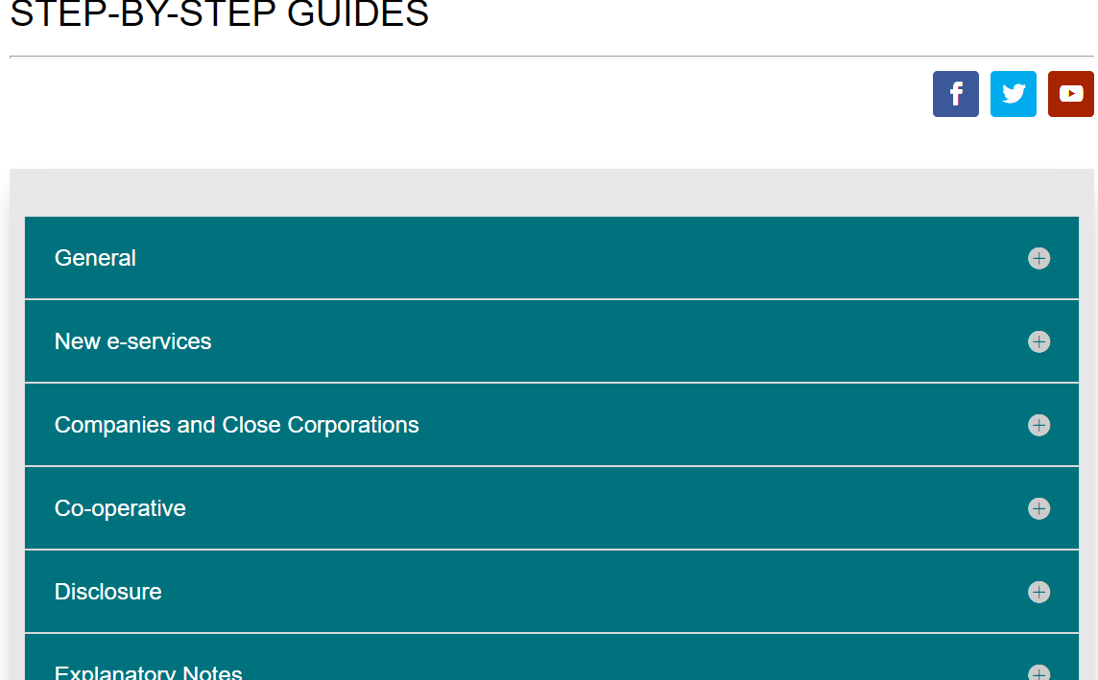
SteP by step guide available on CIPC website (www.cipc.co.za)
Click on the plus sign

Slide 10
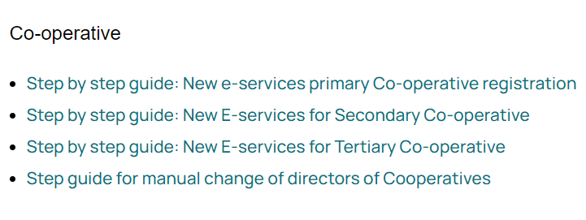
SteP by step guide available on CIPC website (www.cipc.co.za)
The following options for Co-op Guides are:
Click on the Guide for assistance with the application

Slide 14
CO-OP2 Form
The following information has to be completed:
Customer Code as client reference.
Name & Registration Number of the Co-op
The name of the Director or Secretary or Manager or Officer who signed the CO-OP2 form and the form must be dated.
A letter of consent to the appointment of Director must be submitted and the Director is required to state that, he/she is not disqualified to be a Director in terms of the Co-operatives Act, 2005, as amended, or the Constitution of the co-operative and that the Directors listed in the second table have not been re-appointed or have vacated their office for other reasons.

Slide 15
CO-OP2 Form continue
The following information has to be completed:
All active and new Directors details must appear on form CO-OP 2. The following Director details must appear on the CO-OP 2:
Full Names, Surname, Identity number, Date of appointment, Home address, Postal address and demographics namely: Gender: Male, Female, Youth and Person living with a disability.
The number of Directors must at all times be within the minimum & maximum number of Directors as specified in the co-operative constitution.
Clearly certified ID copies or Passport copies of all new and resigning Directors must be submitted.

Slide 16
Certification of documents
Certification of documents may not be older than 3 calendar months.
The Commissioner of Oath that certify or affirm documents must state the date of certification.
Only one ID / Passport may appear on a single page. Both sides of SA ID Cards must be copied on the same page.
Only valid issued Passports will be accepted.
Asylum Seeker / Temporary Resident documents will not be accepted as valid confirmation of Identity.

Slide 17
Certification of documents
SA CERTIFIED DOCUMENTS:
The following information of the Commissioner of Oath must appear on the documents:
Full names and Surname.
Business Address
Signature and date of certification
Designation
Police certified documents must also indicate the Police Officer’s rank and rank number.
The information is required to ensure the Commissioner of Oath is traceable for accountability purposes.

Slide 18
Minutes of meeting
MINUTES
Minutes or resolutions taken at the meeting has to be clear stating either change of name/surname, change of postal address or home address, appointment, resignation, removal, death or end of term of Director.
Minutes must be signed by the Chairperson present at the meeting and be certified a true copy.

Slide 19
Deceased Director
If a Director is deceased, a death certificate must be submitted. If a death certificate cannot be acquired from the family, the co-operative is required to apply for a copy at the Department of Home Affairs.
On the CO-OP2 form the section regarding “DIRECTORS THAT HAVE VACATED OFFICE” must be completed.

Slide 20
Voluntary resignation
The Director must provide a signed letter of resignation and a certified ID copy.
The name and the registration number of co-operative must appear on the letter.
On the CO-OP2 form the section regarding “DIRECTORS THAT HAVE VACATED OFFICE” must be completed.
CHANGE TO DIRECTOR INFORMATION
If the first names, surname, ID number, physical address or postal address of a Director has changed, the minutes must be specific about the changes.
The contact details, first names, surname, ID number, physical address or postal address of a Director on a CO-OP2 form must be the same as that on record with CIPC.
The CIPC record will not be changed if the minutes are silent on the changes, even if the CO-OP2 form and CIPC records differ.

Slide 21
Removal of Director
CIPC is no longer undertaking a verification process, hence the onus is on the co-operative to proof that the correct process of removal was followed.
Notice of the meeting has to be circulated as a record date 14 business days before the meeting.
In the event of removal of Director, the Notice of meeting must reflect the following: Date of Notice of meeting, the Date of the meeting, Time, Place and general purpose of the meeting.
Reason(s) for removal of a Director has to be stated in the minutes and on the CO-OP2 form.

Slide 22
Removal of Director (continue)
Minutes or resolution taken has to be clear stating that it is an expulsion / removal of Director, as well as, proof that the Director that was removed, was afforded reasonable opportunity to make a presentation.
On the CO-OP2 form the section regarding “DIRECTORS THAT HAVE VACATED OFFICE” must be completed.
The resolution must be passed with a majority of Directors present at the meeting.

Slide 23
Submission of co-op2 form & supporting documents
The form and supporting documents must be emailed to: Co-op2@cipc.co.za

Slide 24
Thank you!

