Slide 1

Director changes mashudu Thomas Lebete date: 06 OCTOBER 2022

Slide 2
mANDATE
CIPC is mandated to comply with the following:
Section 66 – 78 of Companies Act
Section 70 – Vacancies on Board
Section 71 – Removal of directors
Section 74 – Directors acting other than at a meeting
Regulation 39 – Directors and register of persons disqualified from serving as a director.

Slide 3
THREE CHANNELS TO SUBMIT
Customers may select to transact either:
Manually – documents must be sent to manualcor39@cipc.co.za
Eservices – documents must be sent to eservicescor39@cipc.co.za
Uploading the documents on website

Slide 4
SUPPORTING DOCUMENTS REQUIRED: CHANGE OF COMPANY DIRECTORS
Required for both manual and eservices transactions:
Minutes of the meeting or Resolution
Round robin resolution or minutes of the meeting signed by all directors as per Practice Note No.1 of 2019
Certified ID Copies of all directors who are affected by the change
Certified ID Copy of the applicant (submission by third part)
In case of deceased director, death certificate is required.
Appointment letter or Resignation letter signed by affected director (Practice Notice No.2 of 2021).

Slide 5
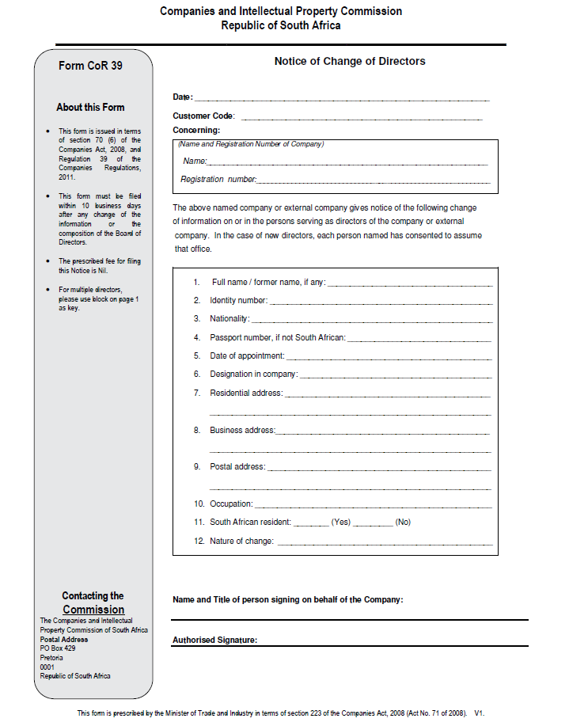
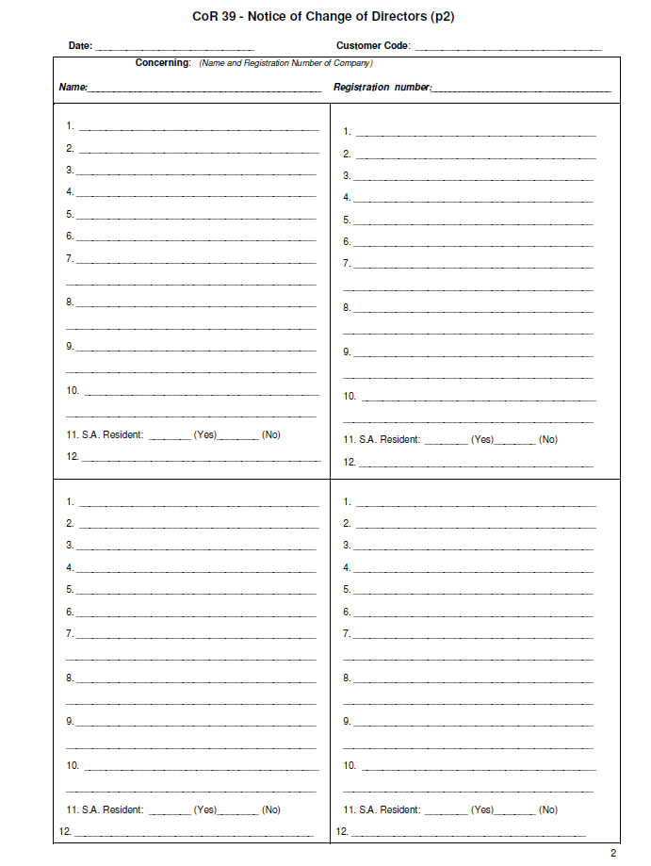
MANUAL APPLICATION

Slide 6
PROCESSING MANUAL APPLICATIONS
Documents must be e-mailed to manualcor39@cipc.co.za
Once received, tracking number is allocated, e.g. 112201935
Boxes are released at the end of the day and work is distributed equally amongst the team members
Application is captured manually by the team members
Outcome (certificate or query) of application is dispatched to the e-mail address linked to the customer code on the form

Slide 7
E-SERVICES TRANSACTION
This transaction is handled by the customer
All changes are captured on CIPC website
Customer will submit application to CIPC for processing
After examining the application, the team member will only Approve or Reject the application
See steps below to transact on e-services:

Slide 8
Removal of a director
Removal and resignation is not the same thing in terms of Companies Act
Removal must be in accordance with section 71 of Companies Act.
A director may be removed by the board or shareholders for committing misconduct such as theft, fraud, forgery, or for neglecting his/her functions as a director.
Application and Resolution/Minutes must have same information, and not removal on resolution but resignation on the form or vice versa.
A Notice must be sent to the affected director with reasons for removal to enable him/her to prepare a response in person or through representative, to the meeting, before a resolution is put to a vote.
Refer to Practice Notice No.74 of 2018

Slide 9
Removal of unauthorised director
This can happen after the expiry of 10 days objecting the filing as required by Company Regulation 168 (COR168).
COR39 form indicating Remove (unauthorised appointment)
There is no need to comply with section 71 since this is unlawful appointment.
Resolution signed by authorised director(s) objecting such appointment and their certified ID copies must be supplied.
Such director will be removed from CIPC records.

Slide 10
Resignation / appointment of a director
This happens due to vacancies on Board of Directors
This may happen as a result of resignation, incapacitated, death, expiry of term of office, retiring, etc.
The company must file COR39 application within 10 business days after a director is appointed or resigned.
The director must handover resignation letter, or accept appointment, and the company must submit COR39 form with Minutes of the meeting or Resolution taken to change directors.
The form and Resolution/minutes must also reflect same information, i.e. not resignation on resolution and removal on the form or vice

Slide 11
Disqualification of a director
A court must make an order declaring a person to be a disqualified director.
A person may be disqualified on the grounds of misconduct involving dishonesty, or has been convicted in any court of law for theft or fraud.
A disqualified person must not be appointed or elected as a director of a company, or consent to be appointed or elected as a director.
Upon rehabilitation of such a director, court order is still required to appoint him/her as a director again.

Slide 12
COR39 PROCESSING TIMES
Manual applications
5 business days turnaround time
E-services applications – no urgent processing
3 business days turnaround time
Customers are encouraged to transact via e-services since this is a much quicker and convenient process that also eliminate spelling errors.

Slide 13
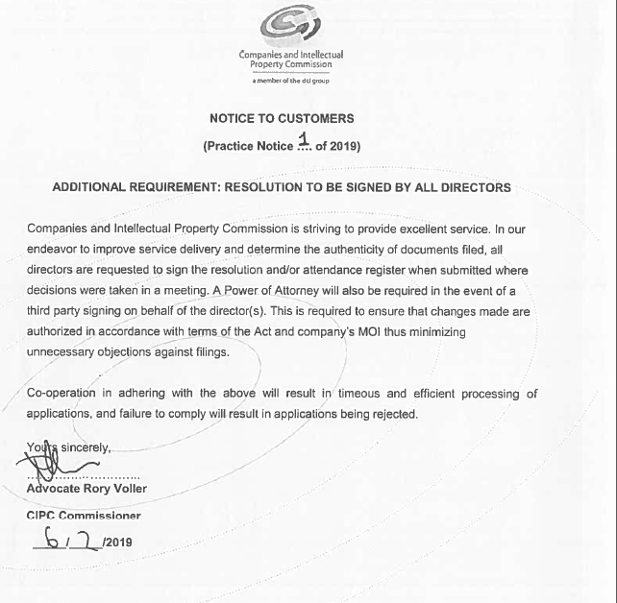
Practice notice no.1 of 2019

Slide 14
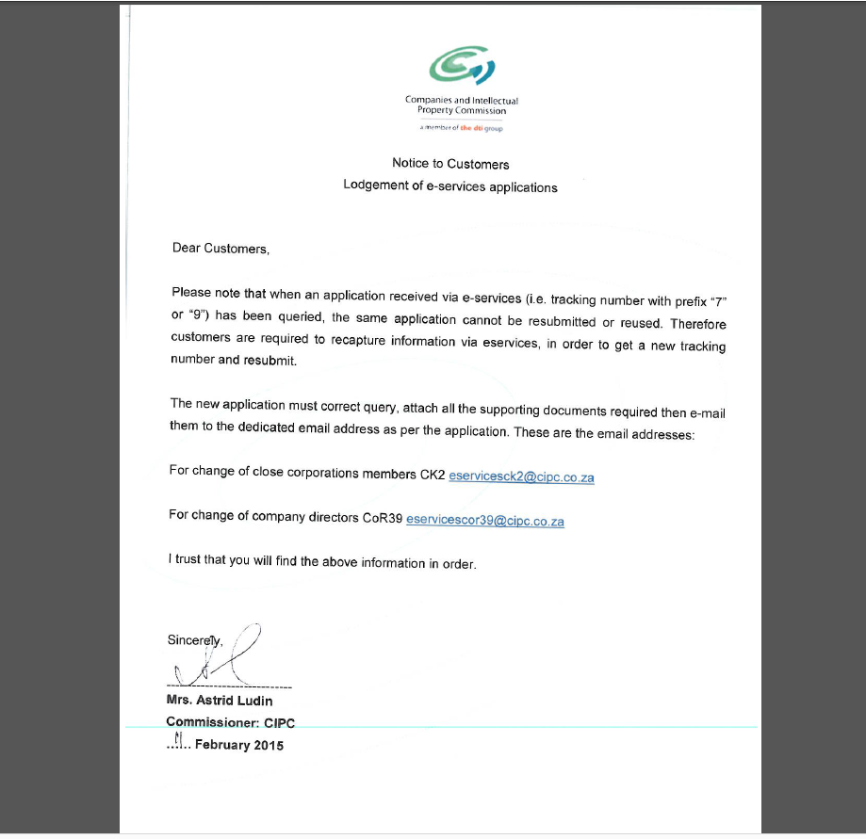
NOTICE TO CUSTOMERS

Slide 15
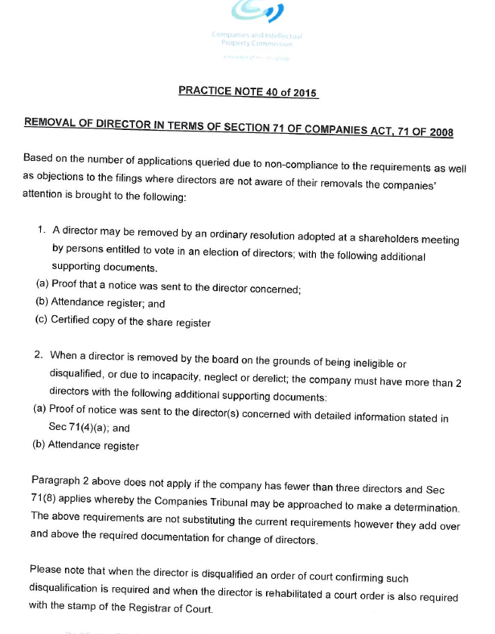
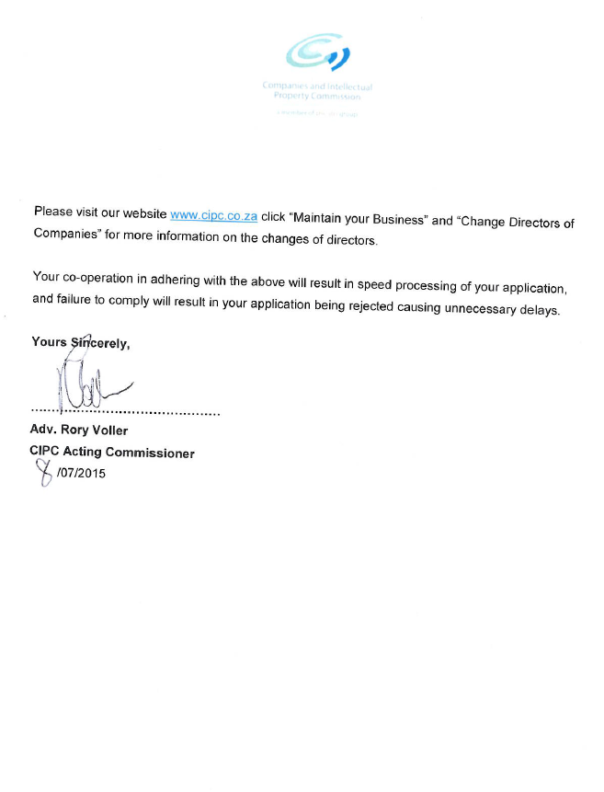
Practice notice no.40 of 2015

Slide 16
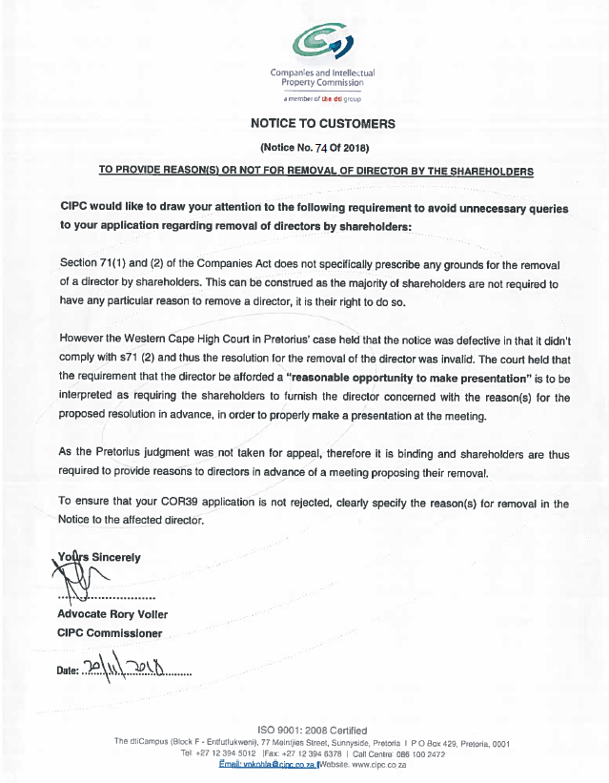
Practice notice no.74 of 2018

Slide 17

Questions & answers

Slide 18
closure

