Slide 1
CC MEMBER CHANGES
Date: 6 October 2022

Slide 2
Mandate
Companies Act Section 187 (4) (d) regarding Functions of the Commission
Close Corporations Act 69 of 1984
Sections 15: Registration of amended founding statement
Section 24: Contributions by members
Section 28: Number of members
Section 29: Requirements for membership
Section 30: Nature of member’s interest
Section 32-38: Acquisition and disposal of membership
Regulations
Regulation 2: Documents
Regulation 16: Registration of amended founding statement

Slide 3
Two Channels to submit
Customers may select to transact either:
Manually – documents must be sent to manualck2@cipc.co.za
Eservices – documents must be sent to eservicesck2@cipc.co.za or the documents can be uploaded on our website

Slide 4
Supporting Documents required:
A written instrument signed by all members including the new members consenting to the changes - it can be in the form of minutes, agreement, resolution etc.
Certified ID copies of all members and resigning members
Certified identity copy of applicant (customer code owner)
In the case of a deceased member, a Letter of Executorship issued by the Master of the High Court. The CK2 document must be signed by the executor. A certified ID copy of the executor must also be attached.
If any of the members cannot be reached to sign the CK2 or refuses to sign the CK2 the CC needs to obtain a court order.

Slide 5
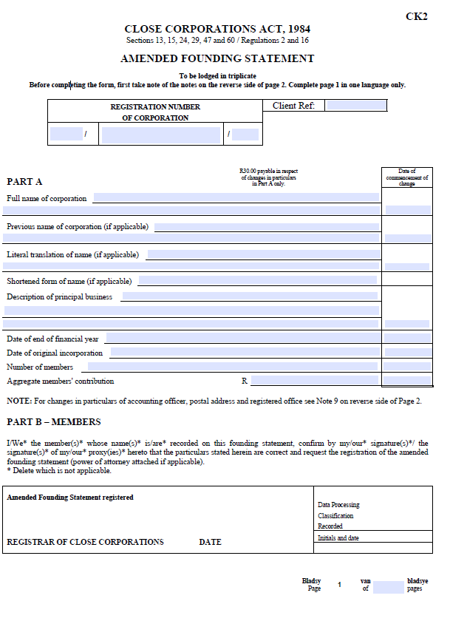
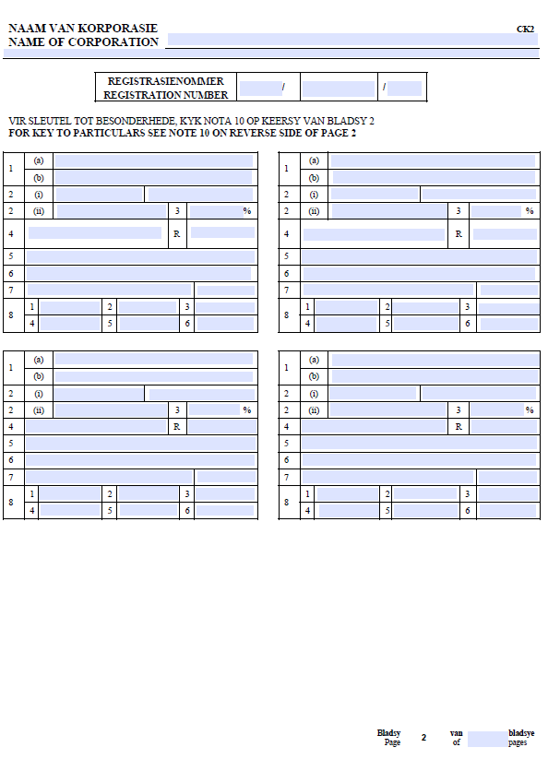
Manual Application

Slide 6
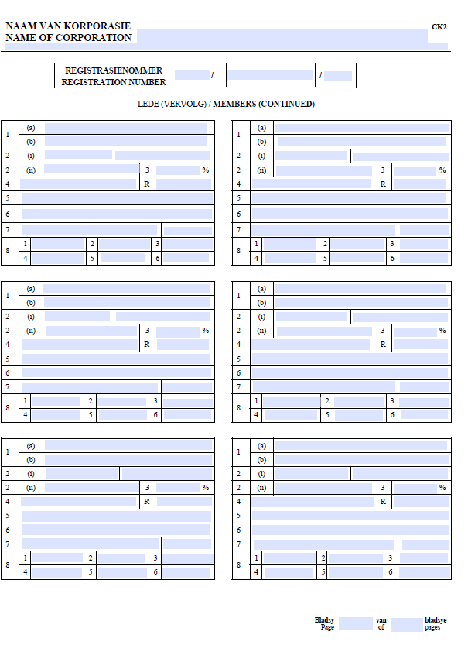
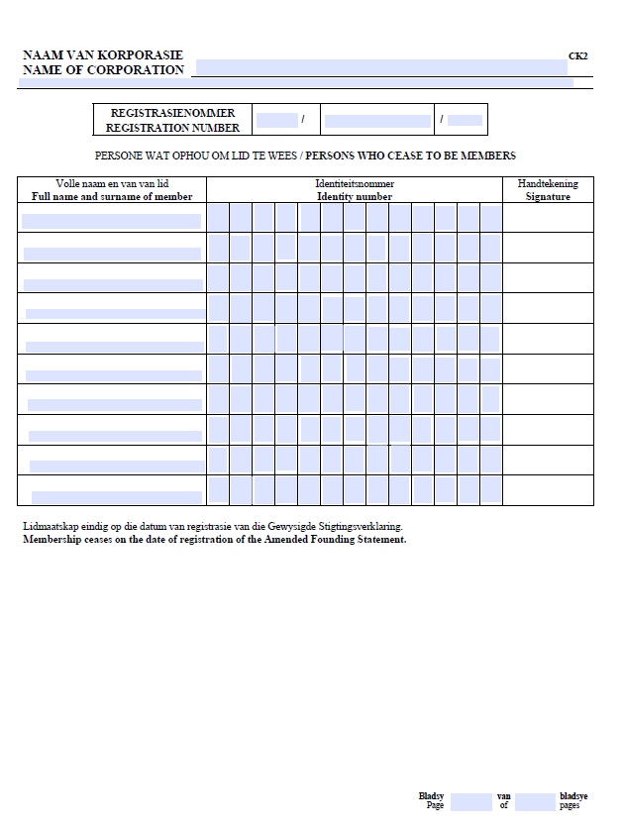
Manual Application (continues)

Slide 7
Processing manual application
Documents must be e-mailed to manualck2@cipc.co.za
Once received a tracking number is allocated, e.g. 111813210
Outcome (certificate or query) of application is dispatched to the e-mail address linked to the customer code on the form.
If the document is queried the whole application must be resubmitted for processing.

Slide 8

E-services Transaction

Slide 9
Log in as customer

Slide 10
Go to Transact

Slide 12
Type in CC registration number

Slide 13
First listed member’s ID

Slide 14
Add new member

Slide 15
Capture new member’s details

Slide 16
Continue to edit details of existing members

Slide 17
Click on Edit

Slide 18
Edit/update details of member

Slide 19
Click on continue

Slide 20
Contribution and interest

Slide 21
Lodgement successful

Slide 22
How to submit e-services CK2
Each member receives a notification of the submission via email and SMS.
An email is sent to the logged in customer, providing the CK2 to be signed and indicating the requirements for submitting the CK2 and supporting documents.
If the customer did not receive the document, it can be requested under “Disclosures/certificates” and then “Re-send member amendment application form”.
CK2 and supporting documents can be uploaded or must be e-mailed to eservicesck2@cipc.co.za with tracking number as the subject of the e-mail.

Slide 23
Trusts as CC members
CK2’s with a trust as member can only be submitted manually. Documents to be submitted as per Practice note 1 of 2006:
A certified copy of the Letter of Authority by the Master of the High Court
A signed Special Power of Attorney by each of the trustees appointing one of them as the representative of the trustees.
A certified copy of the section/s in the trust deed defining and/or identifying the beneficiaries of the trust (Beneficiaries may not exceed 10 when added to the members and a juristic person may not be a beneficiary)

Slide 24
Trusts as CC members (continued)
4. A letter from the representative trustee in which he furnishes:
  The name, registration number and address of the trust,
  The names of all the trustees,
  The number of beneficiaries of the trust, current at date of the letter which are entitled to a benefit from the trust; and
  Particulars of all the beneficiaries named in the trust deed, irrespective whether capital, income or other type of beneficiaries

Slide 25
CK2 Processing time
Manual applications
3 business days turnaround time
E-services applications – no urgent processing
2 business days turnaround time

Slide 26
Thank you

