Slide 1
BENEFICIAL OWNERSHIP “affected companies” & “Non-Affected Companies”

Slide 2
Learn-i-Biz Course
https://www.cipc.co.za/?page_id=10431
Assist new and existing SMME company directors with knowledge of their duties and responsibilities as directors.
Anyone who is interested can register and follow the course.
It is not an accredited course.
It is offered at no cost.
For more information: education@cipc.co.za

Slide 3
Beneficial ownership – companies act
“beneficial owner” in respect of a company, means an individual who, directly or indirectly, ultimately owns that company or exercises effective control of that company, including through-
the holding of beneficial interests in the securities – (section 56) the company’s issued securities may be held by one person for the beneficial interest of another person;
the exercise of, or control of the exercise of voting rights – (section 37) each share issued by a company has associated with it one general voting right, except if provided otherwise by the Act or the MOI;

Slide 4
Beneficial ownership – companies act
(c) the right, or control of the right to appoint and remove directors – (section 66(4) MOI of company may provide for the director appointment and removal of one or more directors by any person who is named in or determined in terms of the MOI of that company;
(d) the ability to otherwise materially influence the management of the company – (section 66) business affairs of a company is managed by its board of directors, which has the power to perform any function of the company.

Slide 5
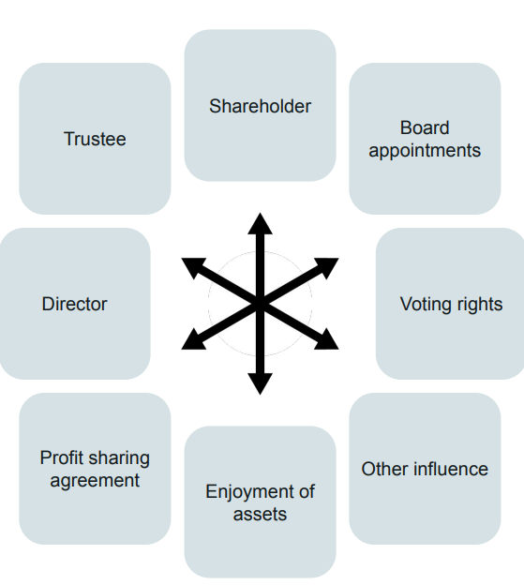
Beneficial ownership – companies act

Slide 6
WHAT IS AN AFFECTED COMPANY?
“affected company” means a regulated company as set out in section 117(1)(i) – as well as companies to which affected transactions and offers and the Takeover Regulations apply, as determined in accordance with section 118(1) and (2)”
An affected company therefore includes-
A public company (listed/un-listed);
A state-owned company (except in case of exemption by Minister);
A private company – in terms of the transfer of securities when exceeding the percentage prescribed by the Minister (10%) within a 24-month period;
A private company that is controlled by an affected company (control or exercise the majority of the voting rights; right to appoint or control the appointment of directors who control majority voting rights at board meetings) or is a subsidiary (majority owned) of an affected company.

Slide 7
WHAT IS AN AFFECTED COMPANY?
Examples of private companies as “affected companies” –
- Company A (declaring private company) is controlled by Company B (affected company) due to B being able to: -
Exercise or control the exercise of the majority voting rights associated with the issued securities of Company A; or
Appoint or elect or control the appointment or election of directors of Company A, who control the majority voting rights at a board meeting.
- Company A (declaring private company) is a subsidiary of Company B (affected company) – meaning Company B owns 51% of Company A’s issued securities.

Slide 8
WHAT IS AN AFFECTED COMPANY?
Examples of being considered “affected companies” –
Transaction or series of transactions done by the regulated company (public, SOC, private) amounting to the disposal of all or the greater part of the assets of the company;
Amalgamation or merger, where at least 1 regulated company is involved;
Scheme of arrangement between a regulated company and its shareholders;
Acquisition or disposal of beneficial interest in the voting securities of a regulated company of 5% or more;
Announced intention to acquire a beneficial interest in the remaining voting securities of a regulated company, not already held.

Slide 9
ENTITY TYPES / CATEGORIES
Non–affected company with beneficial ownership information – companies that are not classified as “affected companies”, and have beneficial ownership information to declare – standard BO-register requirements;
Affected company – companies classified as affected companies, whether beneficial ownership to declare or not – upload mandatory documentation (no BO-information is completed);
Non-affected company without beneficial ownership information – companies not classified as affected companies with zero beneficial owners – upload of mandatory documentation.

Slide 10
SELECTION OF CATEGORIES
In order to guide on the correct process to follow, each entity must answer 2 questions-
1. First, a company must ascertain whether it is an “affected” company or “non- affected” company as per the definition in the legislation;
Once this question is answered, the company must ascertain whether it holds any beneficial owners as per the definition provided for in the Act.
Certain criteria can be applied, when ascertaining whether beneficial ownership is applicable to an entity or not, including:-
5% threshold;
Ownership – members of an NPC, are not necessarily owners; i.e. derives any benefit from the company, etc.
Board of directors exercises effective control – if the answer is yes, then the board is regarded as beneficial owners and can be declared.
The responses to the above 2 questions will guide any company in filing its BO information with the CIPC correctly.

Slide 11
Bo register - categories
Non-affected company with beneficial ownership to declare
Most applicable category;
Beneficial owners (definition applied) declared;
Complex ownership structures – include “disclosure form”;
Filing of securities / members register – mandatory;
NPC’s without members – list of directors.

Slide 12
Bo register - categories
Affected companies – whether BO’s or not
Public companies;
SOC’s;
Applicable private companies (apply the definition);
No BO’s declared on the functionality itself (not exempted from declaration);
Filing of beneficial interest register – mandatory.

Slide 13
Bo register - categories
Non-affected companies without any beneficial ownership to declare
Very rare, but does exist;
Sole shareholder, sole director, without any other influence, control, profit sharing agreements or persons deriving a benefit from the company;
Filing of securities register - mandatory;

Slide 14
BO REGISTER OBJECTIVES
Have a register of natural persons who ultimately owns or exercises effective control over legal entities;
To bring South Africa in line with international best practices – removal from FATF grey-listing;
To provide law enforcement agencies with an accurate, credible and verifiable register of beneficial owners of entities;
To assist law enforcement with relevant information when it comes to their investigations of who the ultimate owners of an entity are and to hold such persons accountable; and
To mitigate the risks identified in the national risk assessment where legal persons were identified as vehicles prone to abuse for money laundering and terror financing activities.

Slide 15
FREQUENTLY ASKED QUESTIONS
Can entities file BO-declarations more than once in a year?
Legislation dictates that entities must file BO-declarations at least once annually, BUT also dictates that the securities register of a company (which includes BO-information) must be kept up to date and any change (amendment) must be filed with the Commission within 10 business days from the date on which the change occurred.
How do you delete or amend an existing BO-declaration?
BO-declarations cannot be deleted and it is a criminal offence to provide false or misleading information to the Commission. However, should BO-information change – such changes must be filed via an amendment, whereby information can be amended, deleted, added, etc. The original information or filing persist (data history).

Slide 16
FREQUENTLY ASKED QUESTIONS
What is a mandate?
Compulsory document, wherein the declaring company mandates a filer (natural person) to submit its beneficial ownership declaration on behalf of the company.
Content of mandate –
Letter / resolution / power of attorney;
Declaring company letterhead;
Mandate to individual (natural person);
Signed by 50% + 1 of directors / all CC members

Slide 17
FREQUENTLY ASKED QUESTIONS
What is the securities register?
‘securities’ means any shares, debentures or other instruments, issued by a profit company (section 1 of the Act). A securities register of a company contains all the information of the securities (including shareholding) issued by the company .
Content of securities register – Regulation 32(3)
Name and ID (unique identifier);
Number and class of securities;
Beneficial interest – extent of interest
Name & ID;
Business, residential / postal address;
Contact info (e-mail)
Beneficial owner information
Full name; d.o.b; ID / passport number;
Residential and postal address;
E-mail address;
Extent of ownership / effective control

Slide 18
FREQUENTLY ASKED QUESTIONS
What is the beneficial interest ? (section 1 of the Act)
‘beneficial interest’ when used in relation to a company’s securities, means the right or entitlement of a person, through ownership, agreement, relationship or otherwise, alone or together with another person to-
receive or participate in any distribution in respect of the company’s securities;
exercise or cause to be exercised, in the ordinary course, any or all of the rights attaching to the company’s securities; or
dispose or direct the disposition of the company’s securities, or any part of the distribution, in respect of the securities.

Slide 19
FREQUENTLY ASKED QUESTIONS
Content of beneficial interest register – Reg 32A
Natural person – full name; ID / passport; country of issue;
Juristic person – full name and reg number;
Business / residential / postal address;
E-mail;
Extent of beneficial interest in terms of issued securities – control (section 56 of the Act)
Disclosure Form (not mandatory)
Complex ownership structures – organogram;
CIPC may at any time require, or cause, the verification of information and documentation – Regulation 5(2).

Slide 20
FREQUENTLY ASKED QUESTIONS
Does a Trust declare beneficial ownership with the CIPC?
Trusts (although regarded as juristic persons) are not registerd with the CIPC, but with the Master of the High Court and therefore must declare beneficial ownership in terms of Trusts with the Master’s office.
However, in instances where a Trust is the owner (member of CC, shareholder of company), in terms of a declaring company the natural persons of these Trusts must be declared, i.e. Trustees (control); beneficiaries (ownership).
.

Slide 21
THANK YOU – QUESTIONS WELCOME!

