Slide 1
Re-instatements of companies & cc enqreinstatements@cipc.co.za

Slide 2
TABLE OF CONTENT
Consequences of Non-Compliance
Final Deregistration
Re-instatement
Incidental information
Learn-i-Biz

Slide 3
Consequences of Non-Compliance

Slide 4
Consequences of non-compliance with Annual Returns
2 + successive Annual Returns outstanding – systematically placed in deregistration
Can still file
Deregistration status is a risk indicator that a company, or close corporation may be coming to an end soon
Banks, service providers or customers may require the company, or close corporation to file Annual Returns for them to do business
Continued non-compliance = final deregistration

Slide 5
Consequences of Deregistration
Company, or close corporation as a registered business ceases to exist
Looses benefits of being a registered business
Perpetual existence
Limited liability
Directors can be held personally liable for all debt
Banks may freeze your bank account
Service providers may stop doing business with you
Creditors may refuse to pay
Until Re-instatement

Slide 6
Final deregistration

Slide 8
Final Deregistration
Status description: AR Final Deregistration
Not voluntary final deregistration
How to determine status: BizProfile
www.bizportal.gov.za / login / BizProfile
Final deregistrations-
January 2024 over 1.7 million
February 2025 over 700 000
Final deregistrations from September 2024 is automated and final deregistration will depend on the day they were referred for AR Deregistrations
Companies and Close Corporations only – not Co-operatives

Slide 9
What Now?
Final Deregistration Notices had been e-mailed to active directors of companies and members of close corporations
Determine whether economic value in name of business AND can proof economic value of business
If economic value – re-instate
If no economic value – new company registration

Slide 10
What Now?
Name becomes available immediately for another person to reserve and use
Deposit made / money in customer account but finally deregistered?
Deposit / money -
Use for re-instatement process
Use for new company registration
Request refund – revenue@cipc.co.za – proof of deposit, stamped confirmation of bank account, certified Identity document of owner

Slide 11
What Now?
If you did not receive the CoR40.3, CoR40.4 and/or Final Deregistration Notice? Why not:
Contact details of directors or members are outdated
Used contact details of a service provider
How to update contact details of directors and members to receive notices in future:
Director / member amendment
Directors must provide their own contact details not that of service providers

Slide 12
Download of letters
If referred for AR deregistration from September 2024 – letters can be downloaded from e-Services and BizPortal
Provided that active director or member at time of deregistration
Use ID number associated with customer code to determine whether letters are available
First six months after final deregistration is free of charge, otherwise a disclosure request need to be filed and must pay for it. Email: disclosureenq@cipc.co.za
Service providers and third parties, will not have access or obtain letters free of charge – disclosure request and must pay for it

Slide 14
Re-instatement

Slide 15
Re-instatement Requirements
MUST have had economic value on date of final deregistration
Example of proof -
Bank statements (most common evidence)
Immovable property - Windeed / Letters from land registry
IP rights e.g., Trade Marks – Extract from Trade Mark registry
Shares – Letter / notification from issuer of shares that company or close corporation hold shares
Outstanding liabilities – e.g., letter / notification from SARS that credit/rebate or outstanding tax liabilities
Lease agreement – must indicate parties and one of the party must be the company or close corporation AND must not have expired
Assets – e.g, car then statement of financier or confirmatory letter or notice from Department of Transport

Slide 16
Re-instatement Requirements
Sufficient documentary proof showing that the company or close corporation was in business/economic value or had outstanding assets or liabilities. Examples of possible proof -
Bank statements (most common evidence)
Immovable property - Windeed / Letters from land registry
IP rights e.g., Trade Marks – Extract from Trade Mark registry
Shares – Letter / notification from issuer of shares that company or close corporation hold shares
Outstanding liabilities – e.g., letter / notification from SARS that credit/rebate or outstanding tax liabilities
Lease agreement – must indicate parties and one of the parties must be the company or close corporation AND must not have expired
Assets – e.g., car then statement of financier or confirmatory letter or notice from Department of Transport

Slide 17
Who May Apply For Re-instatement
Section 82(4) of the Companies Act - any interested person may apply to re-instate a company or close corporation
Only company or close corporation or its duly appointed representative may –
File annual returns;
File Beneficial Ownership Declaration / security register etc.
File AFS/FAS
Third parties do not have such information, and therefore cannot complete re-instatement process since all annual returns and other documents MUST be submitted to complete the process
Third parties, must apply to court

Slide 19
Steps For Re-instatement
Step 1: Determine status (AR Final Deregistration)
Step 2: Assessment as to economic value at time of final deregistration
Step 3: Source all the required documentation and information (for re-instatement, annual returns, AFS/FAS and beneficial ownership)
Step 4: Deposit funds – R200 (must reflect in customer code before sending e-mail)
Step 5: Submit application and all supporting documentation AS A SINGLE E-MAIL to re-instatement@cipc.co.za with all attachments in PDF
Step 6: Submit and pay (file) all outstanding annual returns, latest AFS/FAS and BO
Step 7: Ensure that all director, address etc., is updated

Slide 20
Step 3: Source all the required documentation
An originally completed form CoR40.5 or a letter of similar content
Form: refer to https://www.cipc.co.za/?page_id=3786
Customer code to be indicated on the CoR40.5
If you do not have a customer register one by following the link - BizPortal - Brought to you by the CIPC
If you registered your code, deposit the required funds in your account - BANKING DETAILS | CIPC
Mandate from the applicant on whose behalf the application is being submitted.

Slide 21
Step 3: Source all the required documentation
Sufficient funds in customer code to process the application.
A re-instatement application carries a R200.00 statutory fee.
Deposit the funds, and once the deposit is reflected in your customer code, e-mail the entire application.
Certified ID copy of all active directors/members
Alternatively, if the director/member is deceased, Executor Letter and certified ID copy of the Executor
Certified ID copy of applicant (owner of the customer code)
Certification must not be older than 3 months and Commissioner of Oaths must be clearly identifiable, traceable and designation.

Slide 22
Steps for Re-instatement
Court order to be e-mailed to Corporatelegalservices@cipc.co.za for service and recordal
Important -
Advised that court order must also mandate company or close corporation to bring all obligations up to date within a period of time
Failure of which, company or close corporation will be placed back into AR deregistration for non-compliance

Slide 23
Incidental information

Slide 24
Incidental Information
The submission of the Annual Return Information together with payment should have been made before final deregistration. Mere timeous payment or deposit of fee is not regarded as filing of Annual Returns. The business can be re-instated provided it meets the process and document requirements.
If Annual Returns were filed, but not the latest Beneficial Ownership Declaration, such must be filed separately, failure of which CIPC may initiate an investigation against the company or close corporation and issue a compliance notice.

Slide 25
Incidental Matters
Enquiries and applications - Delays should be expected due to high volume of final deregistrations

Slide 26
How to stay in the Know
Follow CIPC on any of its social media platforms
Refer to the CIPC website regularly www.cipc.co.za
Check your company, or close corporation status regularly
www.bizportal.gov.za / login / View BizProfile
CIPC online director training course (Learn-i-Biz)
https://www.cipc.co.za/?page_id=10431

Slide 28
How to stay in the Know
Keep your company, or close corporation information easily accessible:
Welcome Letter
Registration Certificate
All filing confirmations (and content)
Financial records
Minutes of meetings
Share registers

Slide 29
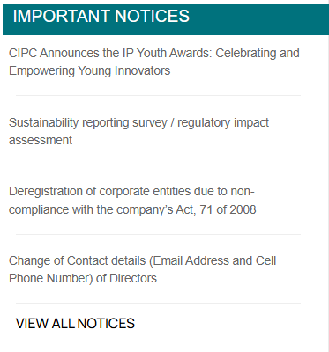
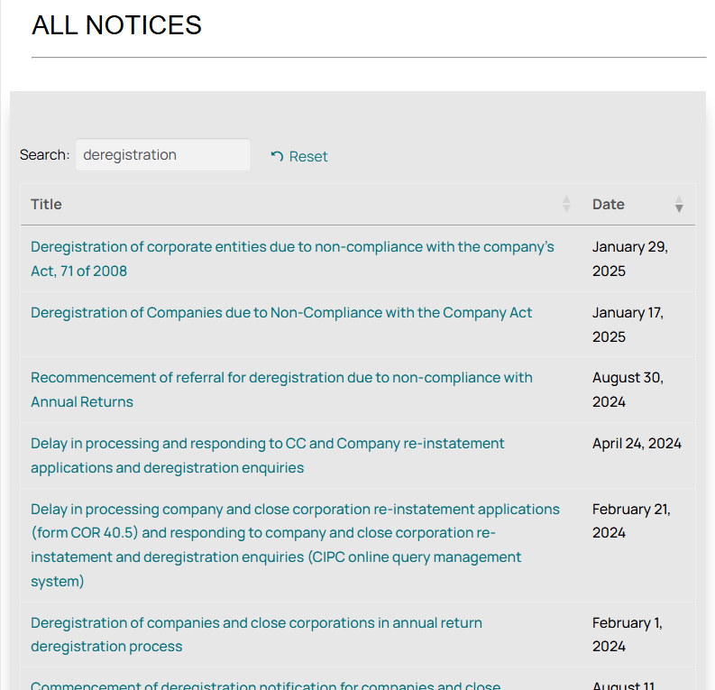
Resources
Notices relating to final deregistration are published on the CIPC website and social media posts

Slide 30
Learn-i-biz

Slide 31
Learn-i-Biz Course
Director eLearning Short Course
https://www.cipc.co.za/?page_id=10431
Email enquiries – education@cipc.co.za

Slide 32
THANK YOU

