Slide 1

OPTIMIZED BENEFICIAL OWNERSHIP DECLARATION

Slide 2
BACKGROUND
The CIPC launched its new Optimized Beneficial Ownership Declaration Functionality on 22 August 2025, aimed at simplifying the process of BO-filing, making it more efficient.
Since the release and to date, the CIPC has received more than 23 000 declarations on the simplified functionality, a testament to its efficacy.
It is important to highlight the fact that the new system does not entail any changes to the legislative or CIPC internal requirements – the differences lie in the simplification of the process and elevating the ease of doing business in South Africa-concept.

Slide 3
What HAS CHANGED?
Beneficial ownership information by corporate vehicles (companies, external companies and close corporations) registered with the CIPC must be submitted to the Commission annually, or as and when the information changes. The optimized system allows non-affected entities WITHOUT beneficial ownership to declare to comply with the legislative requirement of submitting a securities / members register as easily and quickly as possible and to reduce the burden of red tape for small profit companies, NPC’s and CC’s with zero additional ownership, influence or control.

Slide 4
What YOU NEED TO KNOW
No upload of a mandate required. Although entities are still required to ensure that the filer is mandated to submit a beneficial ownership declaration on their behalf, mandates must be retained (and can be requested by the CIPC for filing at any time), but the document does not have to be uploaded – disclaimer confirms mandate in place;

Slide 5
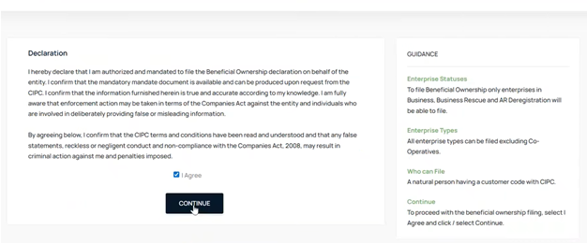
What YOU NEED TO KNOW

Slide 6
WHAT YOU NEED TO KNOW
Filers MUST ensure that the contact details as per the customer profile is correct and valid PRIOR to starting the BO-declaration – the system will provide a link for the update of this information, BUT it will be 48 hours from update before the OTP will be sent to the amended contact details;

Slide 7
WHAT YOU NEED TO KNOW
Company type selection has been reduced to 2 types, namely:-
Affected companies (functionality remains unchanged)
Non-affected companies.
Once non-affected companies is selected, the posed ownership questions will ascertain whether beneficial ownership is applicable or not in terms of the declaration. Where beneficial ownership exist that must be declared, the system will direct filers to the existing beneficial ownership declaration functionality, which remains unchanged;

Slide 8
WHAT YOU NEED TO KNOW
Where no beneficial ownership exists (i.e. no other influence, control, shareholding, etc.) the BO Optimized functionality can be utilized;
Legislation requires the submission of a securities register (or members register) with the Commission, even where no beneficial ownership is declared. With the simplified functionality, entities will be able to complete the securities register online on the functionality itself, with no upload of documents required;

Slide 9
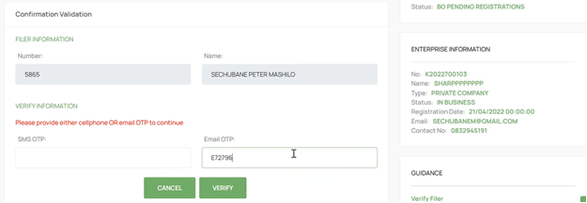
WHAT YOU NEED TO KNOW
Users of the optimized functionality (only non-affected companies WITHOUT BO) will be able to submit either the SMS or E-MAIL OTP, or both, in order to proceed.

Slide 10

Summary and conclusion
The crux of the new Optimized BO-system is that a declaring company must tend to the ownership questions correctly – where no other ownership (excluding directors and members) or control, or any other influence or benefit in terms of the company exist – then the BO Optimized system is for you!
Queries on beneficial ownership declarations can be directed to beneficialownershipenq@cipc.co.za

Slide 11

THANK YOU –
QUESTIONS WELCOME!

